Slide 1
Getting Started with Office 365 APIs

Slide 2
Office 365 APIs for Calendar, Mail and Contacts
Office 365 APIs
Mail Message API
Calendar Events API
Contacts API
Office 365 APIs accessible through REST
https://outlook.office365.com/api/v1.0/me/messages
https://outlook.office365.com/api/v1.0/me/events
https://outlook.office365.com/api/v1.0/me/contacts
Office 365 APIs accessible through OutlookServicesClient
A library which abstracts away sending and receiving REST request

Slide 3
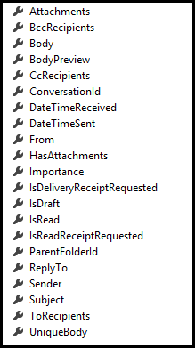
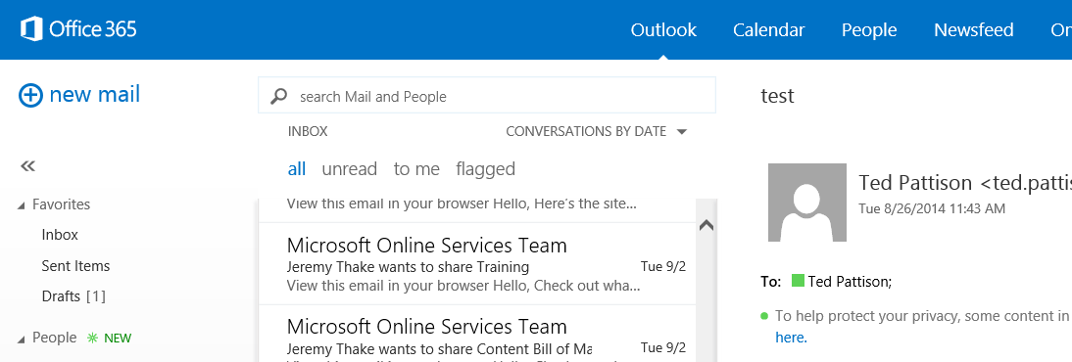
Mail Messages
Message
Common API operations
Reading messages
Deleting messages
Sending messages
Working with attachments

Slide 4
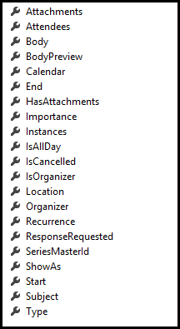
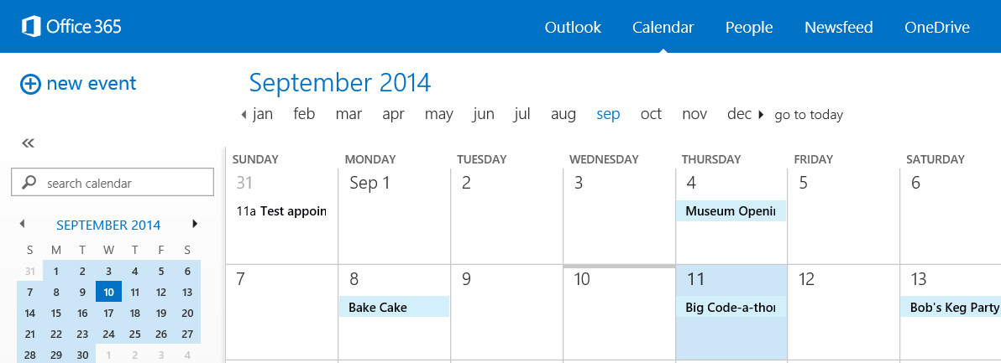
Calendar Events
Common API operations
Reading events for specific date range
Creating events
Deleting events
Editing events
Event

Slide 5
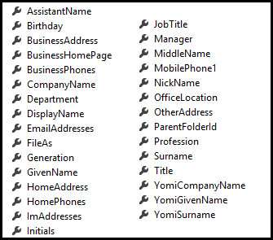
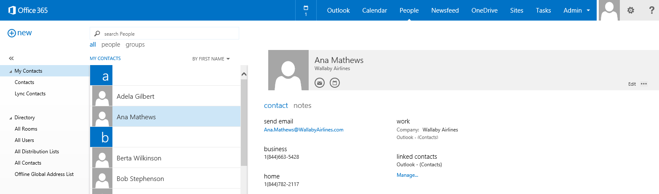
Contacts
Common API operations
Reading contacts
Searching for contacts
Creating contacts
Deleting contacts
Editing events
Contact

Slide 6
Connected Services

Slide 7
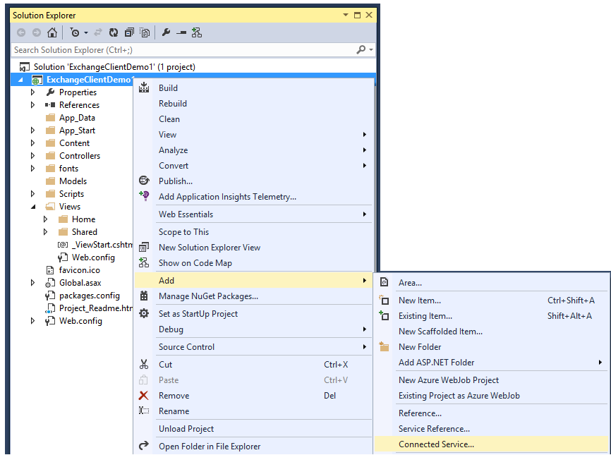
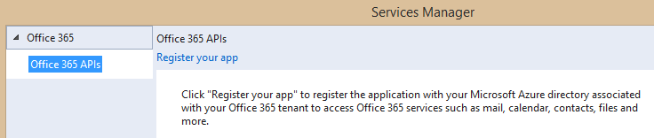
Adding Connected Services
1
Project > Add > Connected Service…
2
Register your app

Slide 8
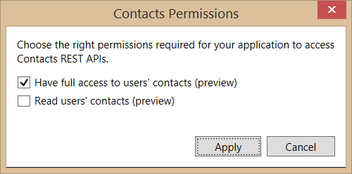
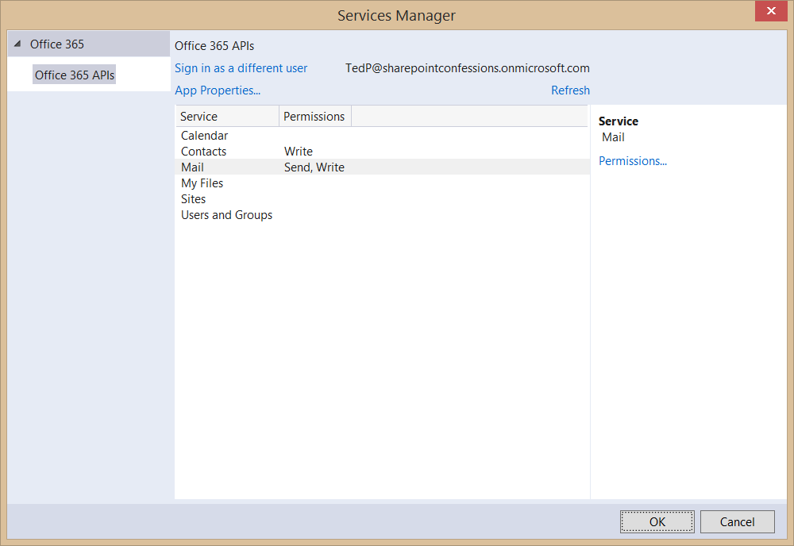
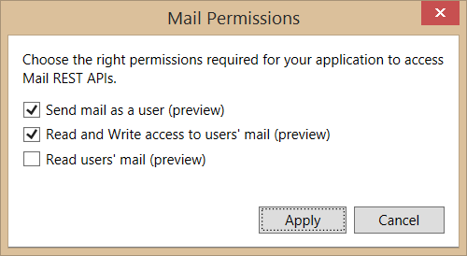
Connected Services Permissions
3
Select required app permissions

Slide 9
demo
Creating an MVC Project that uses Connected Services

Slide 10
demo
Accessing mail messages

Slide 11

Summary
Overview
Connected Services
Paging Support
CRUD Support
Exchange Operations using REST

Slide 12

© 2014 Microsoft Corporation. All rights reserved. Microsoft, Windows, and other product names are or may be registered trademarks and/or trademarks in the U.S. and/or other countries.
The information herein is for informational purposes only and represents the current view of Microsoft Corporation as of the date of this presentation. Because Microsoft must respond to changing market conditions, it should not be interpreted to be a commitment on the part of Microsoft, and Microsoft cannot guarantee the accuracy of any information provided after the date of this presentation. MICROSOFT MAKES NO WARRANTIES, EXPRESS, IMPLIED OR STATUTORY, AS TO THE INFORMATION IN THIS PRESENTATION.

